Slide 1
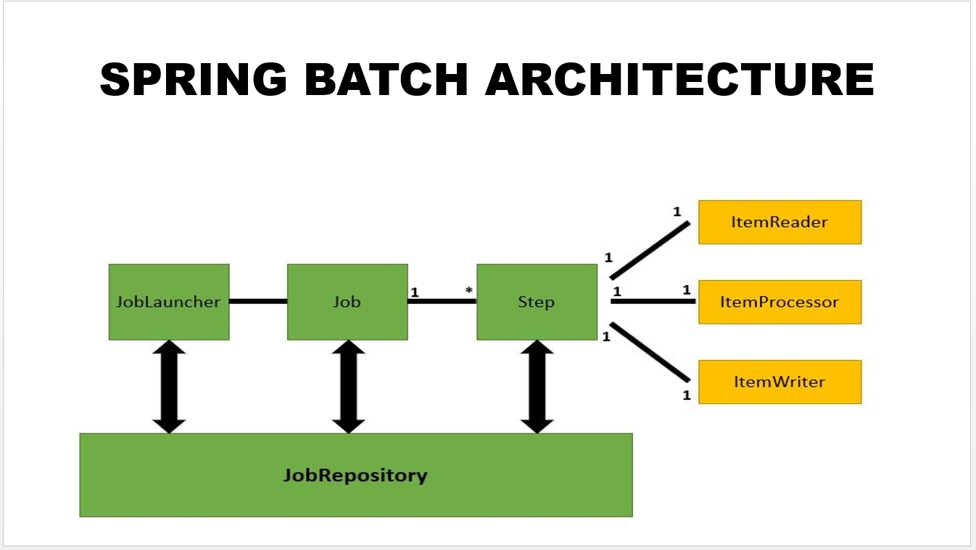
Spring Batch

Slide 2
Agenda
what is batch processing?
batch processing vs. stream processing.
what is spring batch?
what is spring batch job?
Spring batch types of readers
Spring batch types of writers
Concept of chunks vs tasklet
Concept of listeners

Slide 3
what is batch processing?
Batch processing is the processing of large amounts of data in a group or bulk or batch without the need for human intervention once batch processing is underway.
All batch processing can be described in its most simple form as reading in large amounts of data, performing some type of calculation or transformation, and writing the result out.

Slide 4
batch processing vs. stream processing
https://www.geeksforgeeks.org/difference-between-batch-processing-and-stream-processing/
Sequential or parallel or distributed just a technique for processing not a type

Slide 5
what is spring batch?
A lightweight, comprehensive batch framework designed to enable the development of robust batch applications vital for the daily operations of enterprise systems.
Spring Batch provides three key interfaces to help perform bulk reading and writing: ItemReader, ItemProcessor, and ItemWriter.

Slide 6
what is spring batch?
https://spring.io/projects/spring-batch
Spring Boot Batch includes reusable functions such as logging/tracing, transaction management, job processing statistics, job restart, skip, and resource management that are necessary when processing large volumes of records. It also provides more advanced technical services and features that, through optimization and partitioning techniques

Slide 7
what is spring batch job?
A job can have more than one step. And every step typically follows the sequence of reading data, processing it and writing it.
Job can contain multi steps and has job launcher

Slide 8
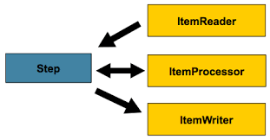
what is spring batch step?

Slide 9
Spring batch types of readers
Flat File:
XML:
Database
https://docs.spring.io/spring-batch/docs/current/reference/html/appendix.html#listOfReadersAndWriters

Slide 10
Spring batch types of writers
ItemWriter is similar in functionality to an ItemReader but with inverse operations.

Slide 11
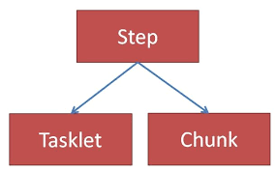
Concept of chunks
As the name suggests, this approach performs actions over chunks of data. That is, instead of reading, processing and writing all the lines at once, it'll read, process and write a fixed amount of records (chunk) at a time.
Then, it'll repeat the cycle until there's no more data
https://www.javainuse.com/spring/batchtaskchunk

Slide 12
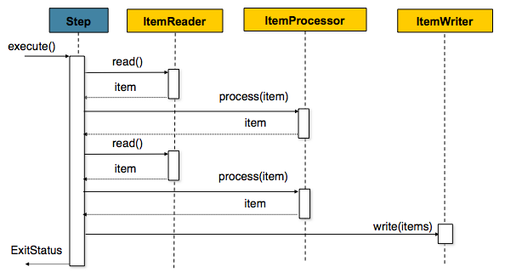
Concept of chunks
https://docs.spring.io/spring-batch/docs/3.0.x/reference/html/configureStep.html

Slide 13
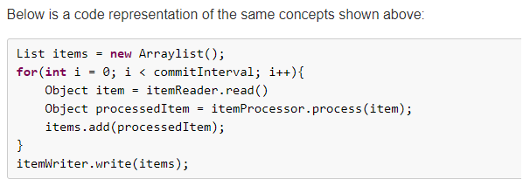
Concept of chunks
As a result, the flow will be slightly different:
While there're lines:
Do for X amount of lines:
Read one line
Process one line
Write X amount of lines..

Slide 14
Concept of listeners
As Spring Batch jobs can run for long times, providing progress information is often critical. For example, which Job is in progress, what all jobs have failed and what all have been completed. All such information can be gathered using the batch event listeners.
https://howtodoinjava.com/spring-batch/spring-batch-event-listeners/

Slide 15
References
https://docs.spring.io/spring-batch/docs/current/reference/html/readersAndWriters.html#readersAndWriters
https://docs.spring.io/spring-batch/docs/3.0.x/reference/html/configureStep.html

